Slide 1
Web Development
CSE343
Lab 11

Slide 2
Agenda Overview
What is Web3?
Blockchain fundamentals
Smart contracts
Wallets & transactions
DApp Architecture
Real examples & use cases
Sockets and Web Sockets
Sockets vs HTTP
Web Sockets Applications
Sockets and Security
Examples

Slide 3
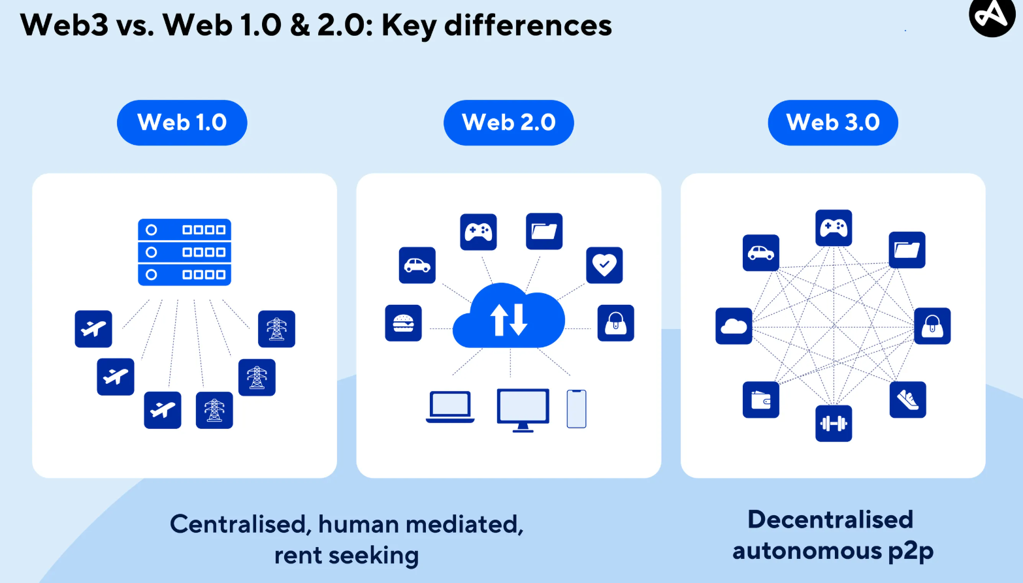
What is Web 3?
Web3 is the next generation of the internet, emphasizing decentralization, user ownership, and blockchain-based technologies.
What are the previous Generations for comparison?
Web1: Read-only, static content
Web2: Read-write, social, centralized platforms
Web3: Read-write-own, decentralized, user-centric

Slide 4
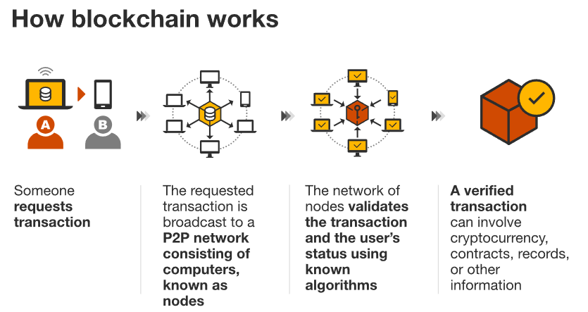
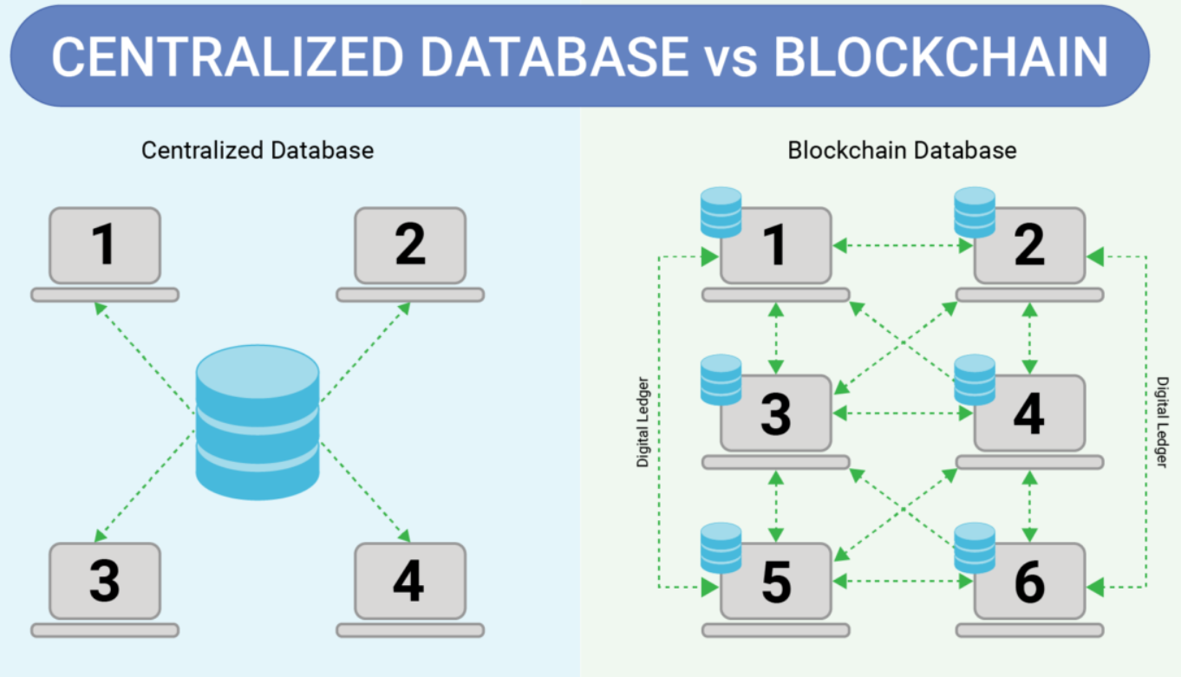
Web 3 Core Technologies – Blockchain
Blockchain in Web3 is the foundational technology that enables decentralized applications (DApps), digital ownership, and trustless interactions on the internet.
Blockchain is a digital database or ledger that is distributed among the nodes of a peer-to-peer network.
Instead of storing data on a company-controlled server (Google, AWS, Meta…), blockchain stores information on a distributed network of nodes.
What this means:
No single party controls the database
Data is tamper-resistant (found on many nodes)
Users own their own data
Example: A smart contract that stores user balances across thousands of nodes.

Slide 5
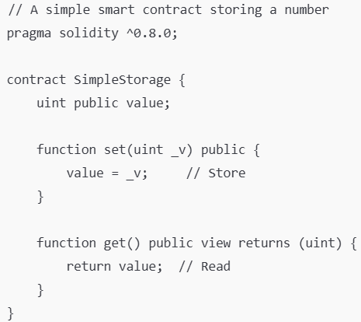
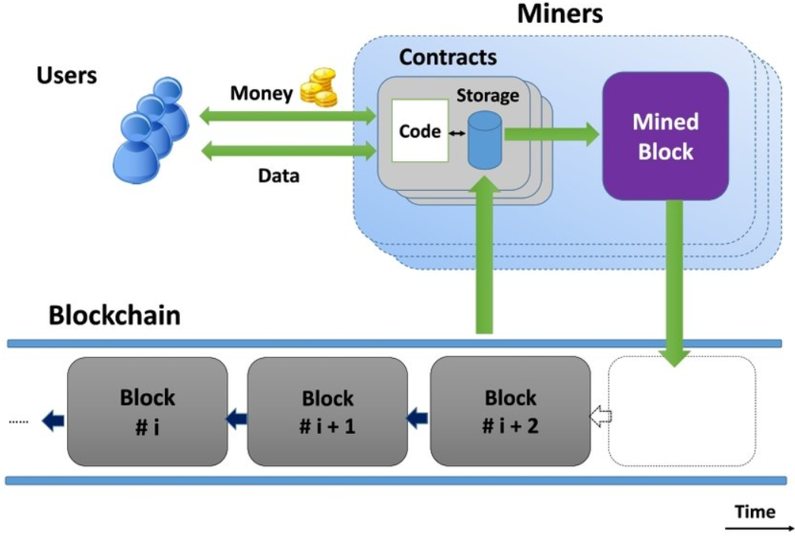

Web 3 Core Technologies – Smart Contracts
Smart Contracts: Self-executing code enabling automation and trust. The code of smart contracts run on blockchain nodes to validate and verify transactions as they enable:
Automated logic
Transparent rules
Immutable behavior
Self-executing agreements
Think of it as a backend API, but on the blockchain and as code that no one can change after deployment. It is digital contract that executes itself when conditions are met with no any human intervention or central regulation.
Example code for a smart contract using Solidity Programming Language (of Ethereum Cryptocurrency)

Slide 6
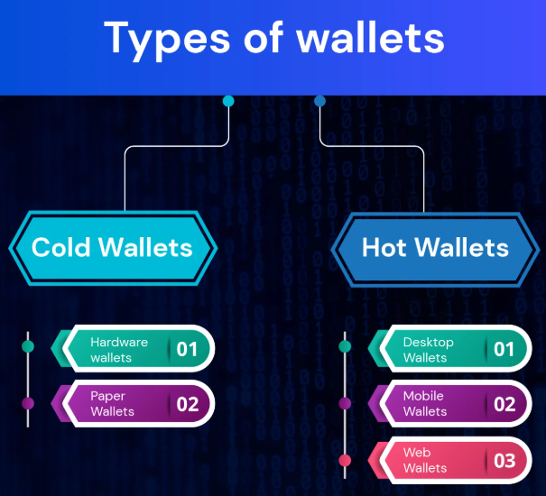
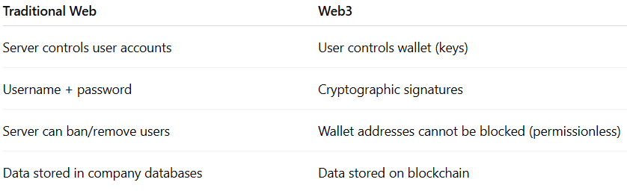
Web 3 Core Technologies – Digital Wallets
Digital wallets are another foundational concept in Web3, and they are essential for understanding how users interact with blockchains, smart contracts, and decentralized applications.
A digital wallet (or crypto wallet) is a software (hot wallet) or hardware (cold wallet) tool that allows users to store private keys, send & receive cryptocurrency, interact with smart contracts, and log in to DApps (without a username/password)
Important: A Web3 wallet does not store coins physically. Coins live on the blockchain. Your wallet stores the keys needed to access them.
Wallets have public key (there known address – like your bank account number). Private keys should not be shared as this will allow others to access your coins and tokens.
Wallets are your identity in Dapps. You use them to approve transactions and manage your tokens.

Slide 7
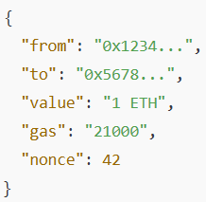
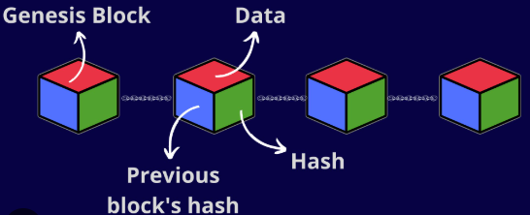
Web 3 Core Technologies – Transactions and Tokens
Transactions can be made to “move” currency from one wallet to another in exchange for digital assets (tokens) – or even physical assets in some cases.
Each transaction should include the “gas” needed to process the transaction from which the miners are paid the money based on the gas price.
Gas needed for each operation on the blockchain vary based on the complexity of the operation. Smart contracts should be optimized to not have high gas consumption and be expensive to compute.
This feature is important not only for paying miners who validate the blockchain transactions, but also to prevent DDOS like attacks on blockchains due to gas depletion with long operation.
Transactions stored on the blockchain are “chained” in sequence through hashing. Each new block has the hash of the previous block to know the sequence of the blockchain.
Tokens can be of different types like USDT, unique arts or digital assets in games etc.

Slide 8
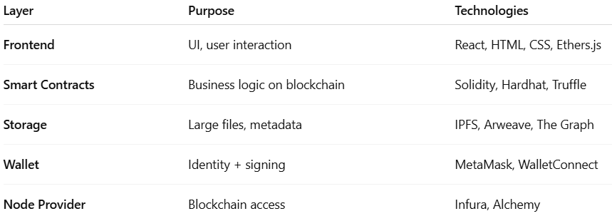

Decentralized Applications – dApps
Frontend Example
Layout 1: Web3 Login Page
"Connect Wallet"
Display account address
Show token balances
Layout 2: Dashboard
Balances
Pending transactions
Smart contract functions UI
Layout 3: Interaction Panels
Forms for sending transactions
Buttons calling contract functions
Notifications for confirmations
A DApp is an application whose backend logic runs on a decentralized blockchain network instead of centralized servers. The application still has a UI/Frontend like any normal web app, but the logic, storage, identity, and trust rely heavily on blockchain technology.
The frontend is built normally using HTML/CSS and React elements. However the API endpoints that were previously used to interact with the backend change. The frontend can interact with the “backend smart contracts and blockchain” using APIs like web3.js. WEB3 JS Github Link
Blockchains are expensive for storing large data, so DApps use decentralized alternatives like IPFS (InterPlanetary File System) for images, files, metadata

Slide 9
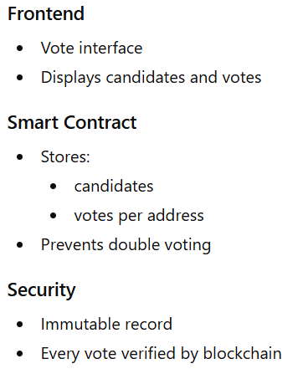
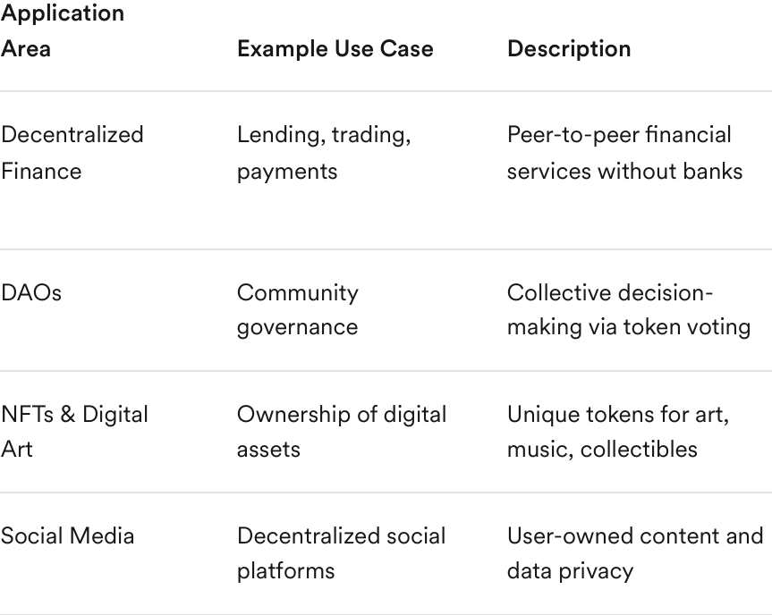
Decentralized Applications – Examples
10 Examples of Decentralized Applications (dApps) to Know in 2023 - Core Devs Ltd You can check real applications that rely on the blockchain for operation from this link.
What is common between Dapps is that they are:
Open-source and autonomous
Operate via smart contracts
No single point of control or failure
Users interact directly with the blockchain

Slide 10
Sockets and WebSockets

Slide 11
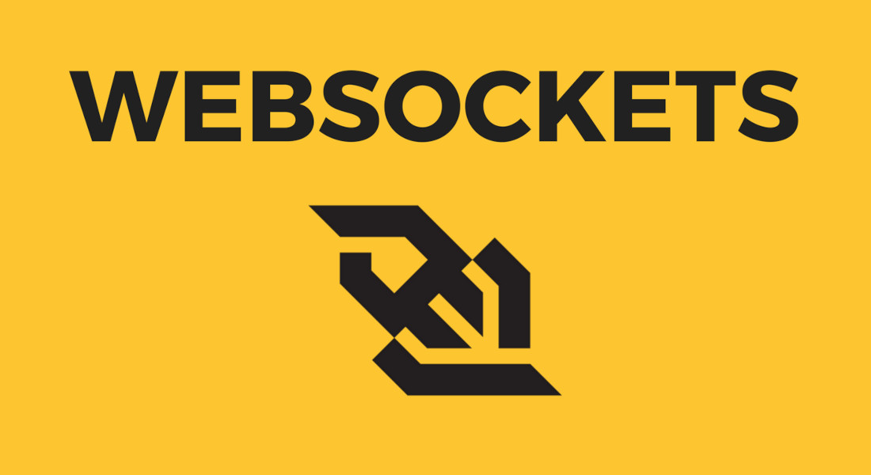
What are Sockets and WebSockets?
A socket is a low-level communication endpoint that lets two programs exchange data over a network.
Think of sockets as pipes connecting two machines. With both sides reading/writing bytes. Used in operating systems and programming languages (C, Java, Python, Node, etc.)
Classic sockets follow: TCP → reliable stream UDP → fast but unreliable
These sockets are not browser-friendly by default. A protocol that is based on TCP connection and browser friendly is WebSocket.
WebSockets are a modern full-duplex communication protocol running over a single TCP connection. Why they matter? Because of real-time communication for browsers as both server and browser can send/receive at any time.

Slide 12
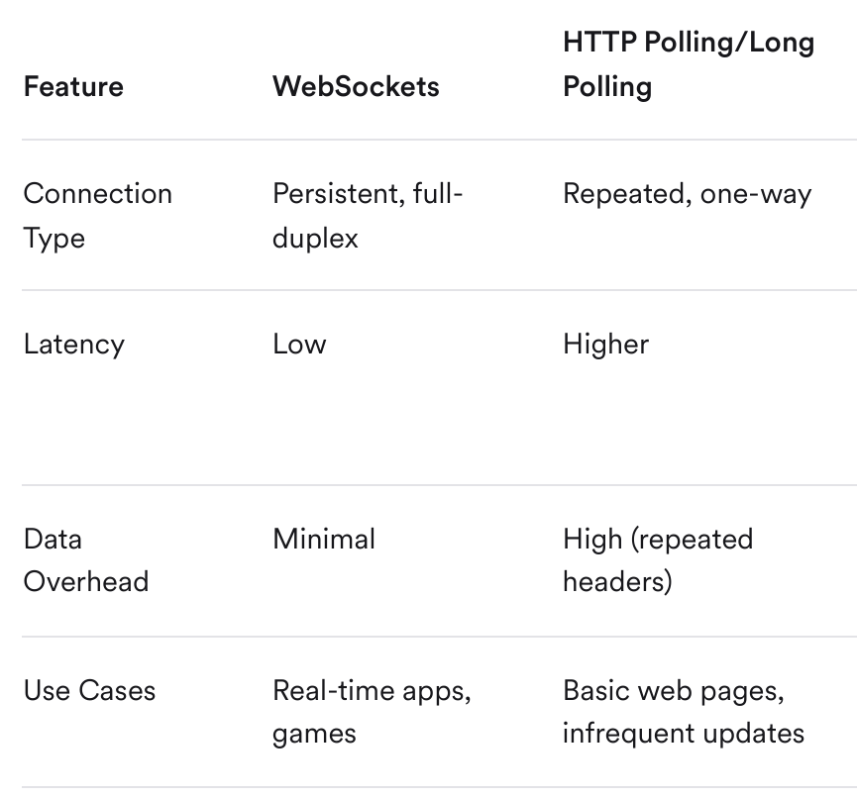
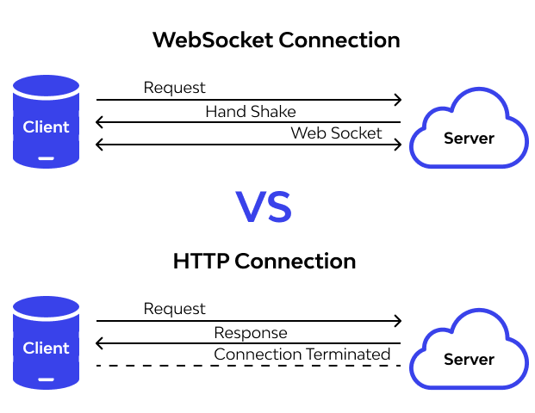
WebSockets vs HTTP?
WebSockets allow both the client (such as a web browser) and the server to send and receive data at any time, without the need to repeatedly open new connections. The connection starts as a standard HTTP request, then is "upgraded" to a WebSocket connection through a handshake process. Once established, this connection remains open, supporting full-duplex (simultaneous two-way) communication.
PS: WebSockets are more “Realtime” than HTTP

Slide 13
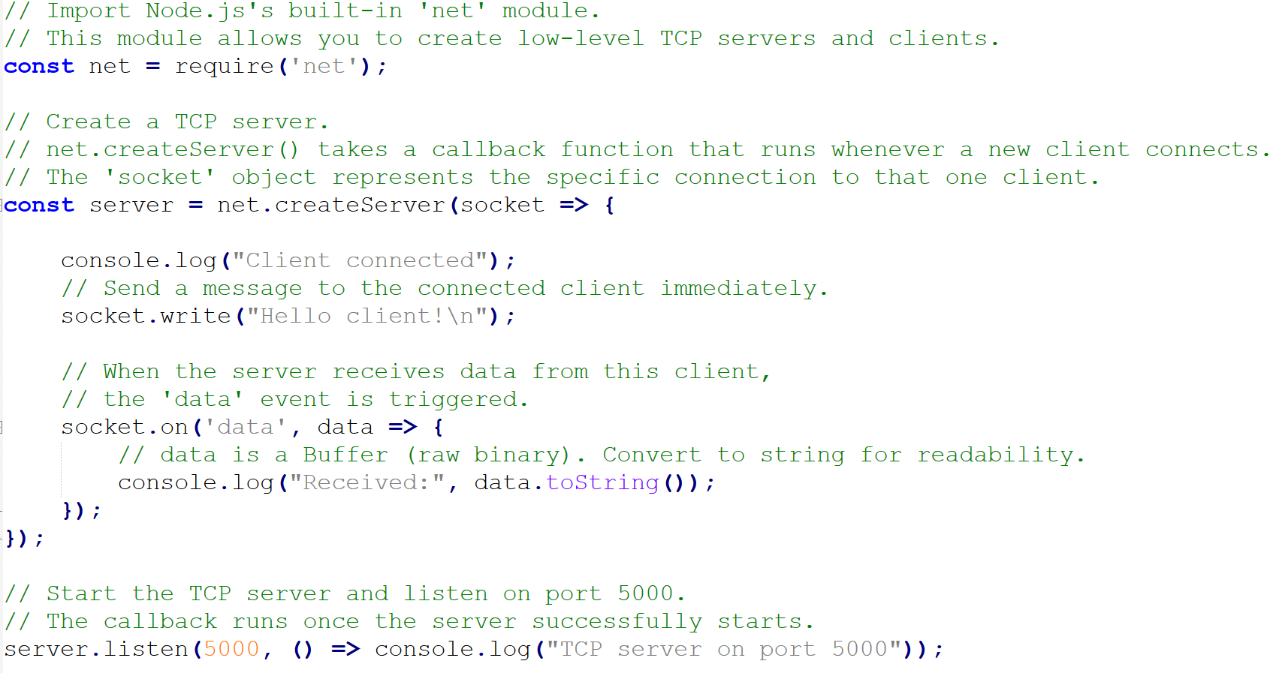
Sockets in Action using Node

Slide 14
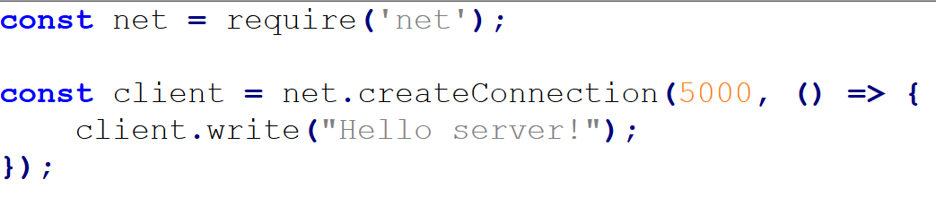

Sockets in Action using Node
Client connecting to server socket on port 5000
What do you think will happen if more than one “write” operation is made in the connected socket?

Slide 15
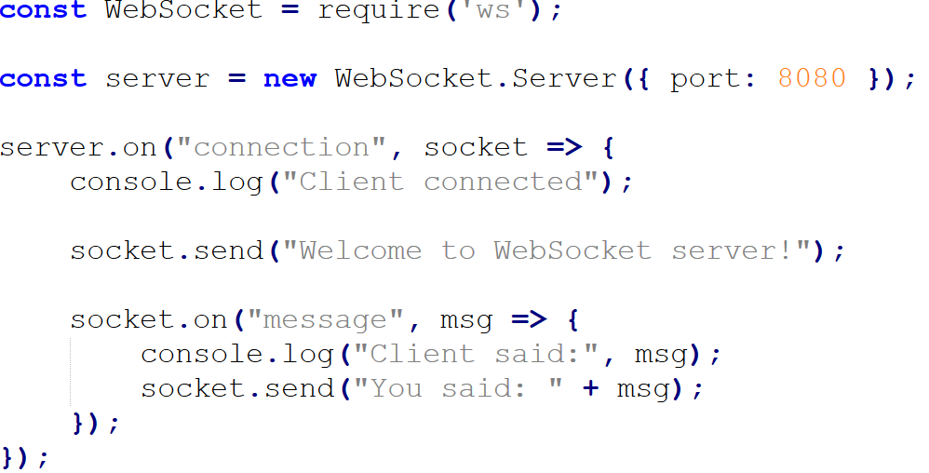
WebSockets in Action
WebSockets allow real‑time bi‑directional communication. To use it in node, you need to install it similar to what we did before with express and mongoose using: npm install ws

Slide 16
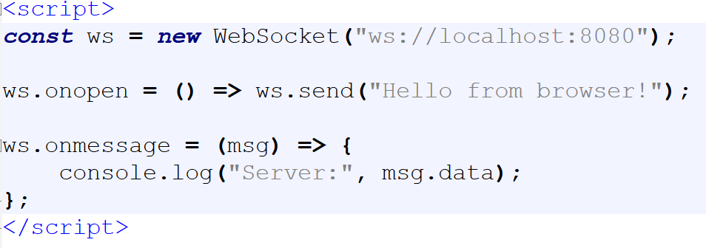
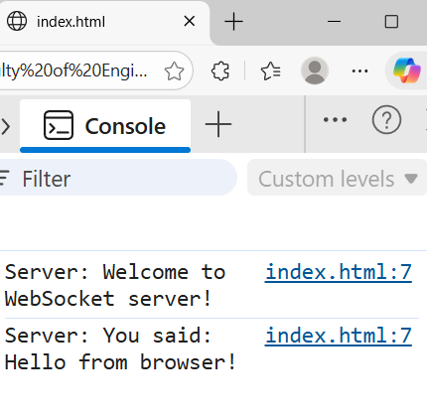
WebSockets in Action
WebSockets allow us to test now using the web browser as the client. (Most real scenarios of frontend communicating with the backend will be made through the web browser)

Slide 17
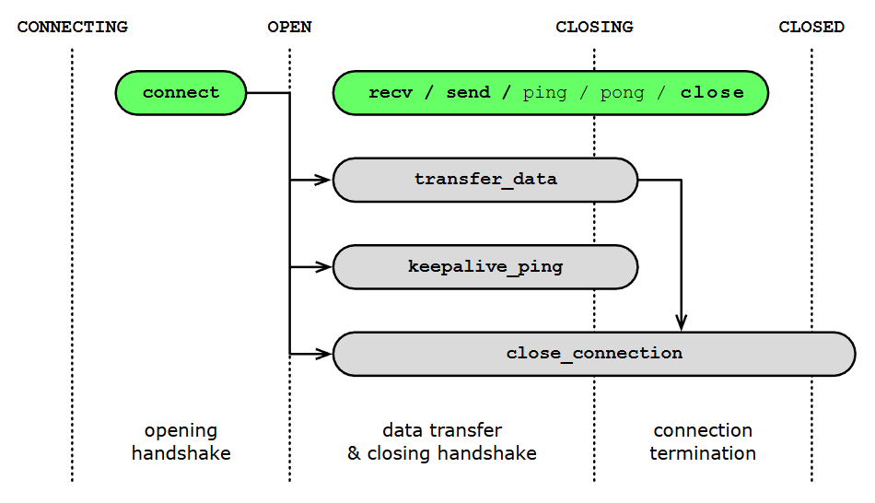
WebSockets Lifecycle
Any websocket should be handled in each stage of its lifecycle including 4 main operations CONNECT → OPEN → (SEND/RECEIVE) → CLOSE
Your server is now running and you can access it through the web browser
The browser WebSocket API gives you four main events:
✔ onopen Called when the connection is established.
✔ onmessage Called when the server sends data.
✔ onclose Called when the connection is closed.
✔ onerror Called when something goes wrong.
Another important feature in sockets and web sockets is
that multiple clients can be connected to the server on the
same socket.

Slide 18
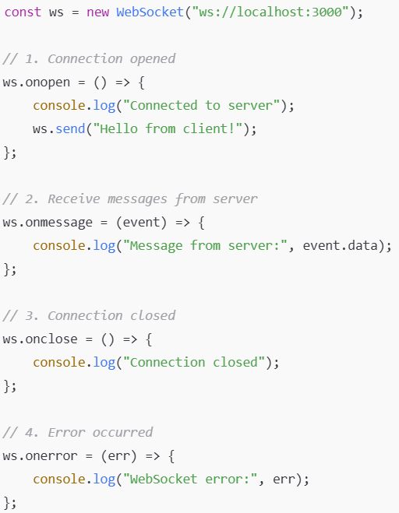
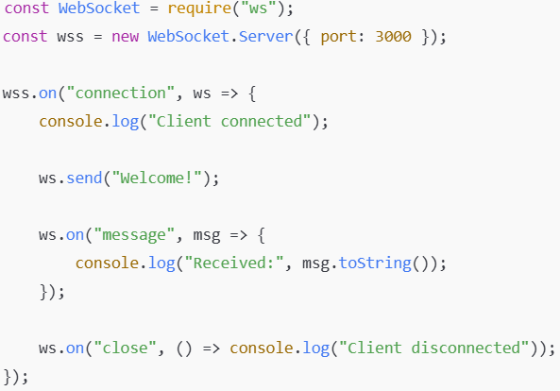
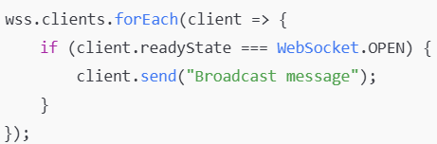
WebSockets Lifecycle
Client
Server
Send to multiple clients

Slide 19
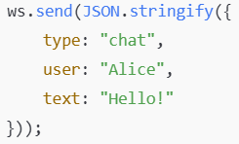
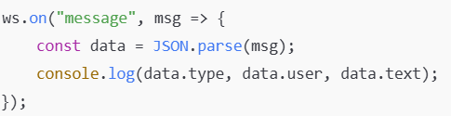
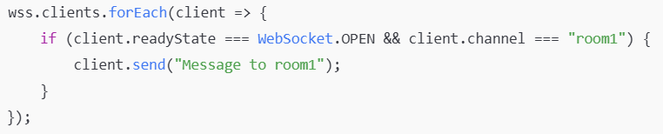
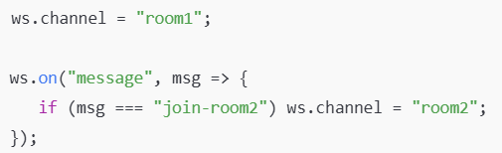
Sending and Receiving JSON
Client
Server
Sending to specific clients (based on channel)
Server
Client

Slide 20
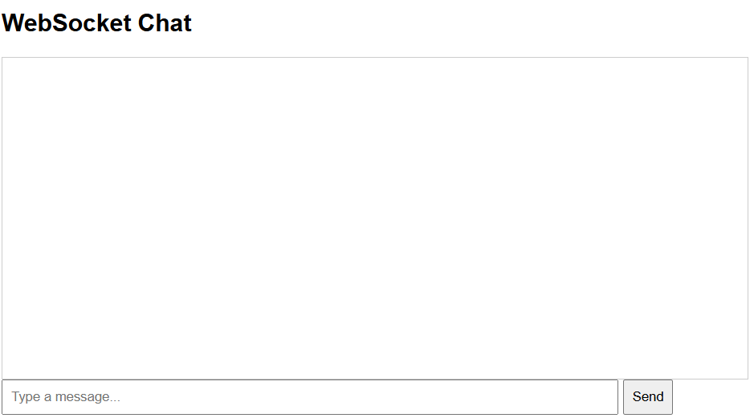
Lab Demo: Chatting APP

